Slide 1
Bootstrap
SE 3355 Web Development
Lect. Barış Ceyhan

Slide 2
Motivation
Build fast responsive sites FAST
Rich library with ready css and js, ready to use
Everything on http://getbootstrap.com, great documentation
Currently at 5.3.x
Customizable and upgradable

Slide 3
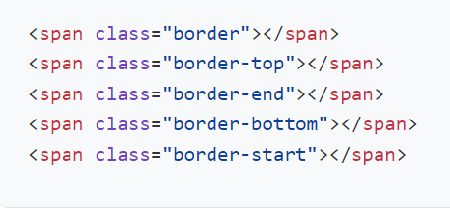
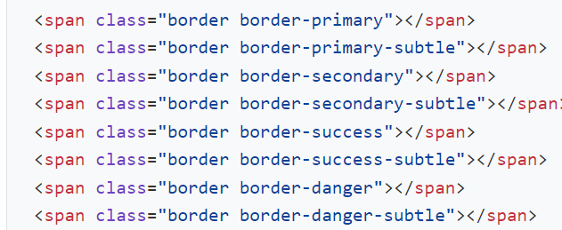
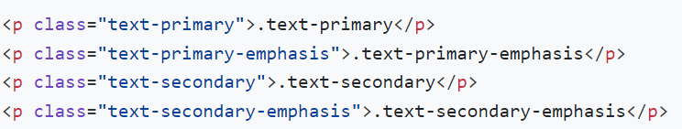
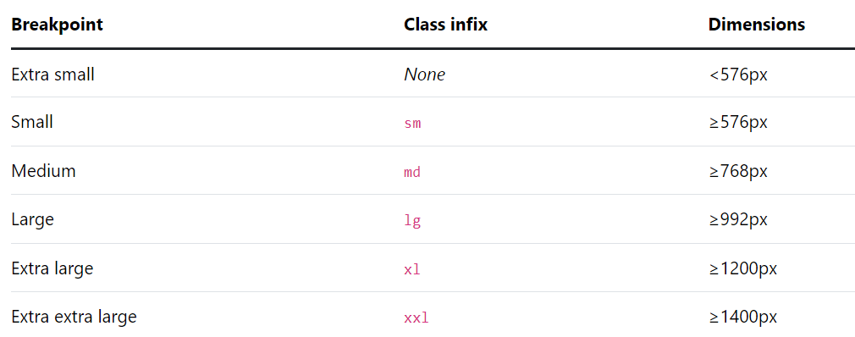
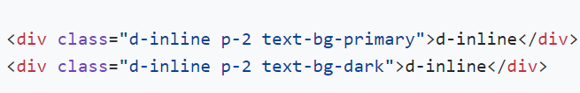

Utilities/Borders, colors, display, breakpoints, shadow
ready-to-use borders, with colors
Color, backgrounds
Checkout layout/breakpoints first
Different display types
Shadow – cards etc

Slide 4
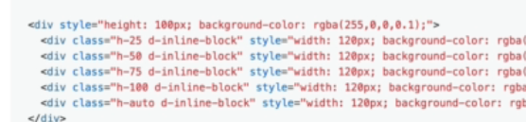
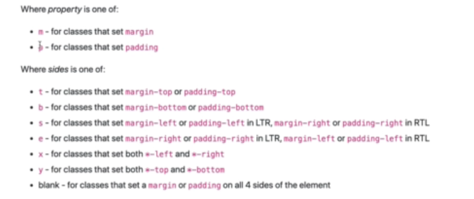

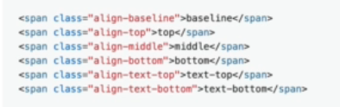
Utilities width height margin padding
Width
Height
Parent element important
Margin padding, negative margin gap
Vertical alignment
visibility

Slide 5
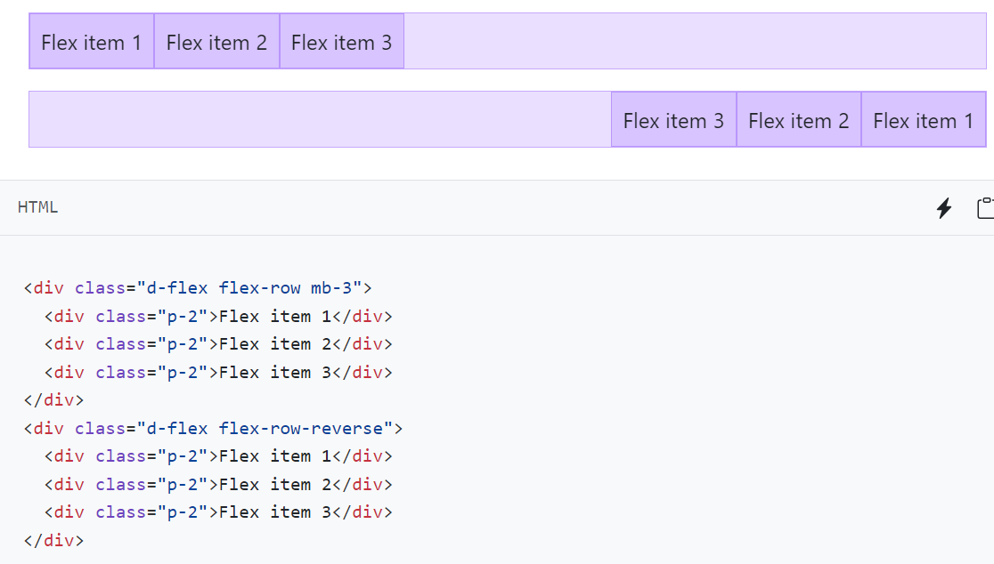
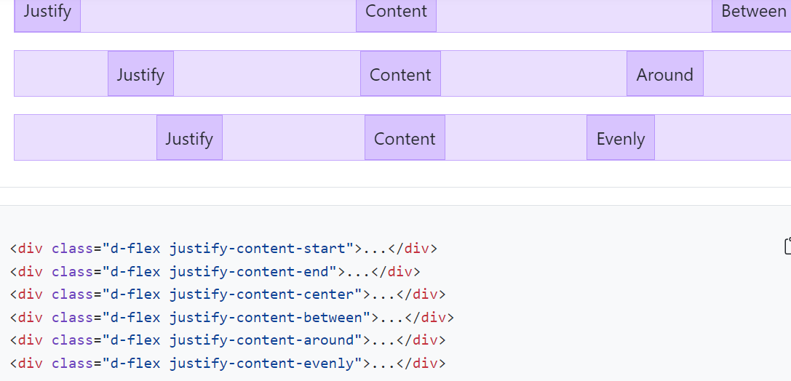

Layout/flex – utilities/float

Slide 6
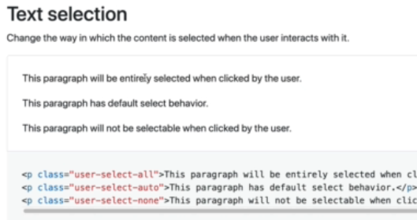
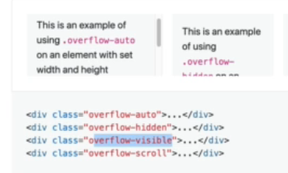
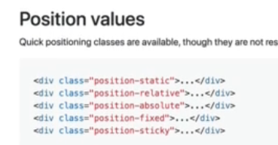
Utilities/interaction, overflow, positioning
user-select. API key selection etc
Pointer events
overflow*
position*
Absolute inside relative. Rule #1
translate*

Slide 7
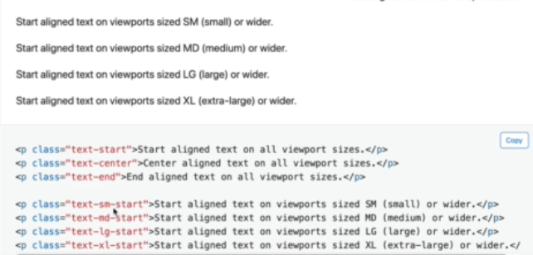


Utilities/text
Alignment, wrapping, overflow
Word-break
Transform. text*
Font size. fs
Highlight
Font weight. fw*
Line height. lh*

Slide 8
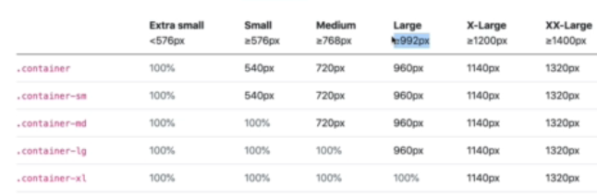

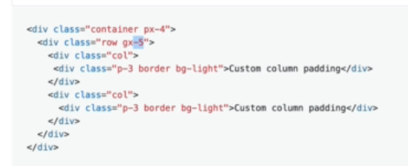
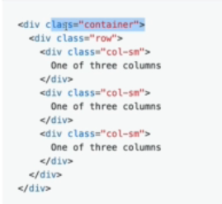
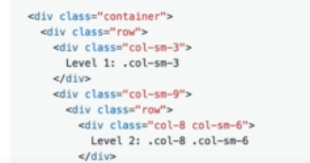
Layout – container, grid system
container*
Row, col, nested
Gutters – space between

Slide 9
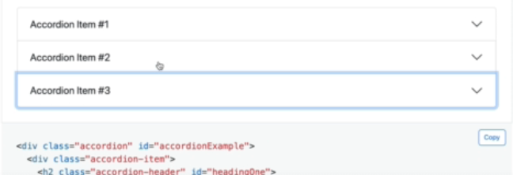
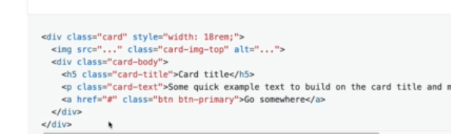
Components – ready to use
Need js
Carousel, accordion
Alert
Toast
Modal
card

